Slide 1
Can proprioceptive training improve motor learning?
Duncan Tulimieri
Wong et al., 2012
November 17, 2021

Slide 2
Introduction
Proprioception is affected by motor learning
Hand position sense altered after
visuomotor adaptation
force field adaptation
Hand position sense acuity can be increased
Learning process includes both sensory and motor changes
Can proprioceptive training improve motor learning ?

Slide 3
Materials and Methods
Apparatus

Slide 4
Materials and Methods
Experimental protocol
3 consecutive days, ~25 mins/day
Goal movement: circle w/ 10 cm radius
Challenging, complex, natural, positional and velocity errors can be separated
Proprioceptive training
240 active + 80 demonstration trials
Familiarization
10 trials
Baseline
20 trials

Slide 5
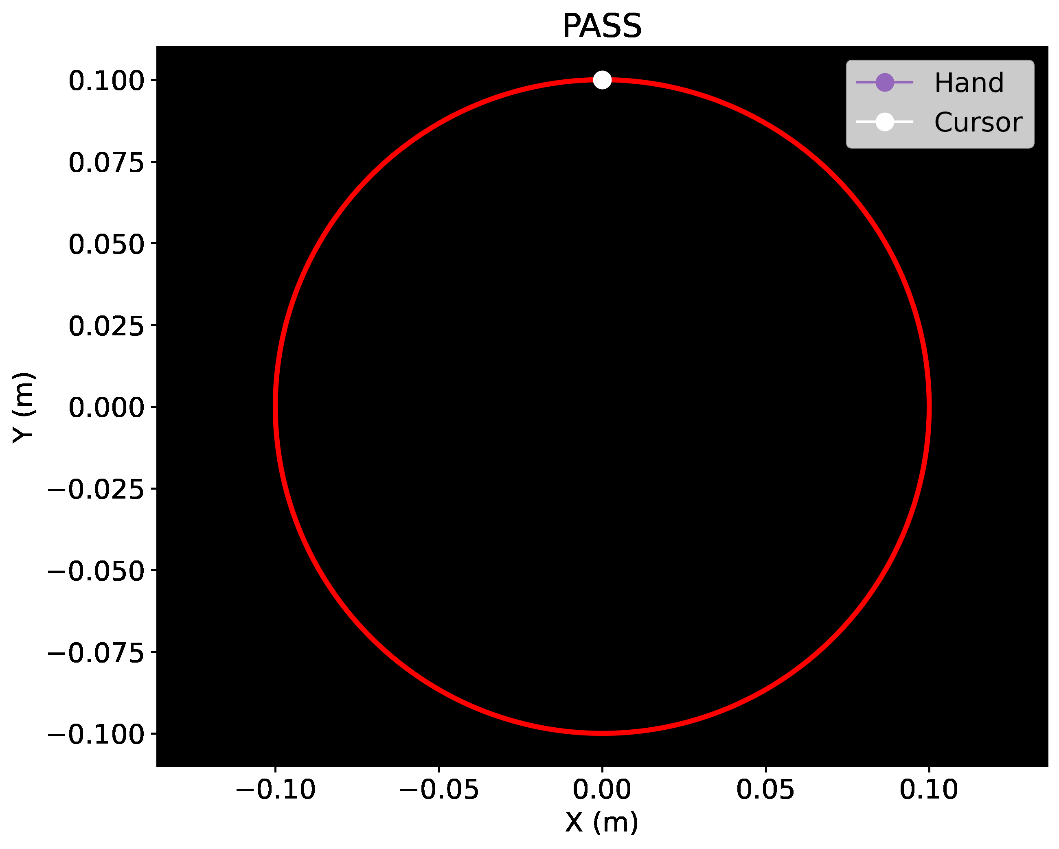
Materials and Methods
Proprioceptive training
Demonstration:
Demonstrations of desired movement
PASS: robot passively move arm
Training:
Notes:
- Can see red, white, not purple

Slide 6

Materials and Methods
Proprioceptive training
Demonstration:
Demonstrations of desired movement
PASS: robot passively move arm
CTRL: visual only
Training:

Slide 7

Materials and Methods
Proprioceptive training
Demonstration:
Demonstrations of desired movement
PASS: robot passively move arm
CTRL: visual only
REV: hand move CW, cursor CCW
Training:

Slide 8

Materials and Methods
Proprioceptive training
Demonstration:
Demonstrations of desired movement
PASS: robot passively move arm
CTRL: visual only
REV: hand move CW, cursor CCW
ACT: robot passively move and instructed to actively move
Training:

Slide 9
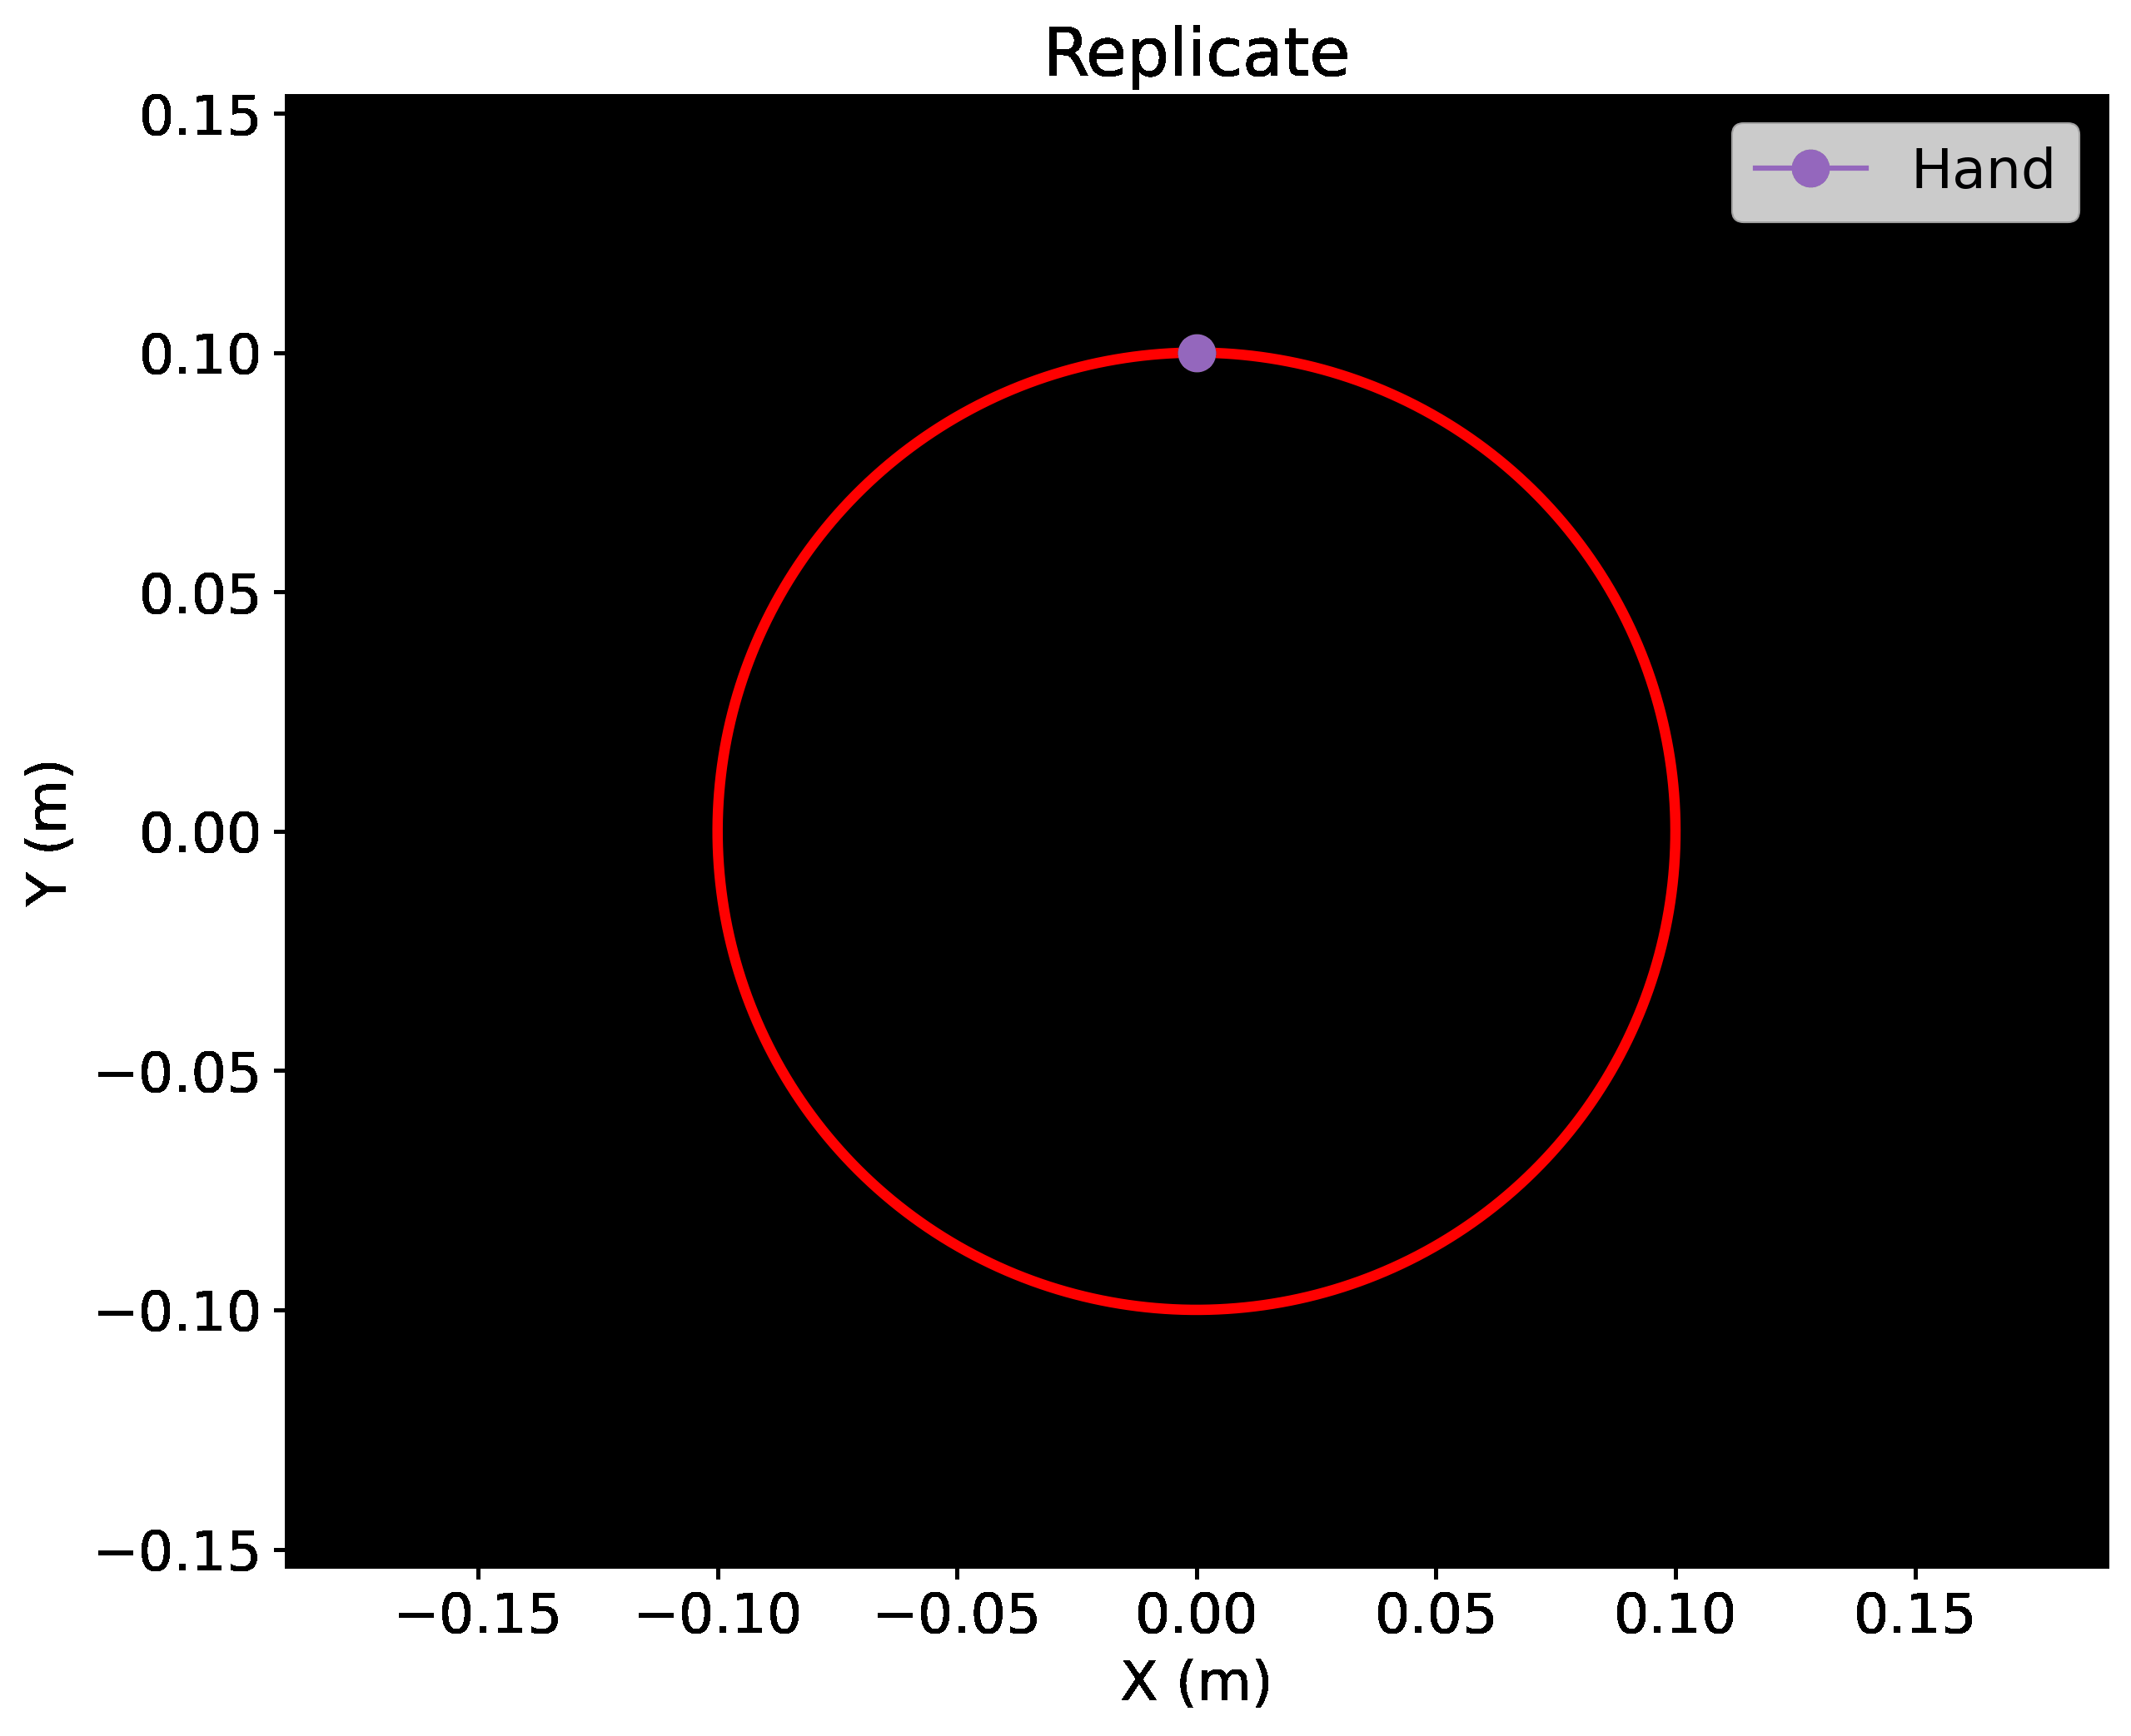
Materials and Methods
Proprioceptive training
Demonstration:
Demonstrations of desired movement
PASS: robot passively move arm
CTRL: visual only
REV: hand move CW, cursor CC
ACT: robot passively move and instructed to actively move
Training:
Replicate desired movement (no vision)
Notes:
- can only see white cursor

Slide 10
Materials and Methods
Data analysis
Cross correlation index (CCI)
Correlation between desired and produced signal for x and y
Positional error
Absolute distance between produced radial distance of hand and desired radial distance
Velocity
Average over trial

Slide 11
Results
0 = no deviation between desired and actual position signals
Cross correlation
worse
better
Notes:
PASS learned positional information better than CTRL
Trial = 10 movements

Slide 12
Results
Movement velocity
Notes:
PASS learn better than CTRL
36 cm/s desired

Slide 13
Results
Positional error
Notes:
- PASS learn better that CTRL

Slide 14
Results
Proprioceptive specificity
Benefit of passive proprioceptive training due to experienced movement trajectory
Other task relevant information
Timing
Attention
REV group
Magnitude of tangential velocity + range of joint angles experienced same as PASS
Movement duration same as PASS
Similar attentional demands

Slide 15
Results
worse
Proprioceptive specificity
REV similar to PASS
better
Notes:
- REV similar improvements to PASS

Slide 16
Results
36 (cm/s) = perfect
Proprioceptive specificity
REV similar to PASS
Notes:
- REV similar improvements to PASS

Slide 17
Results
Proprioceptive specificity
REV not learn like PASS
Notes:
- REV similar improvements to PASS

Slide 18
Results
Active proprioceptive training
Learn similarly to passive
Helps improve motor performance but not positional accuracy
ACT trials were uninformative if active movement against handle did not result in positional errors
Mean force ACT > mean force PASS

Slide 19
Results
Other complex movements

Slide 20
Results
Other complex movements
worse
better

Slide 21
Discussion
Is this proprioceptive training ?
Possible explanations
Proprioceptive training allows better representation of desired movement
Execution errors better perceived when desired performance is in sensory space
Proprioceptive training change how signal to muscles are computed
Proprioceptive remembered active movement is better than passive movement
*** only for self-defined movement

